Slide 1
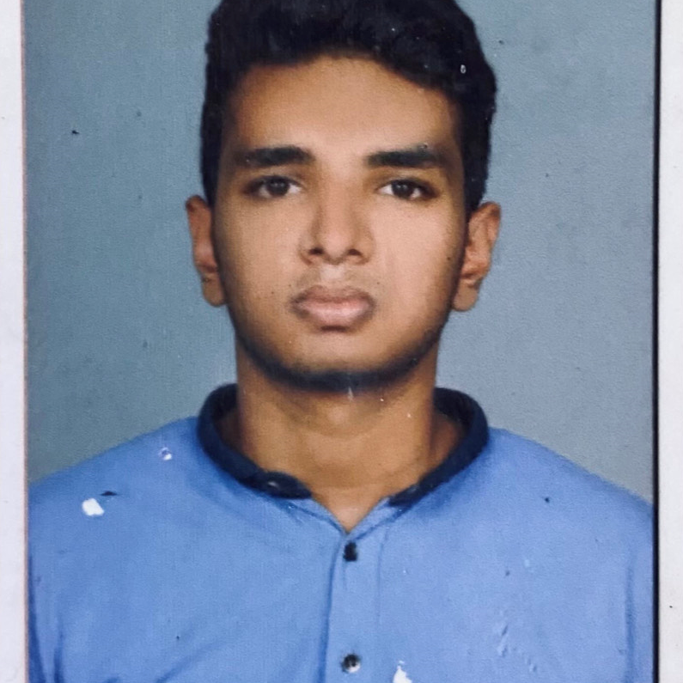

SIDHARTH KB
Analyst/Software Engineer
Bachelor of Technology
MECHANICAL ENGINEERING :2018-2022
Skills
Bangalore
Java 8 /J2EE | Java Basics, OOPS, Generics, Collections, Arrays, Loops, Lambda Exp, Stream API Junit, Mockito, Servlets
Spring core | IOC & Dependency Injection, Autowire
AWS Cloud | Completed level 0 and level 1 aws cloud certification
Spring REST | REST controllers, Implementation of GET, POST, PUT & DELETE, Bean Validation & Exception Handling, Testing Services, Controller & Repository layer
Spring Data JPA | Implement DAO layer using spring Data repositories, Transaction Management
Spring Boot Microservices | Spring Boot Starters, annotations, Messaging Service, Sync/Async comms, Swagger API specifications
Spring Cloud | Eureka
React | Components, Hooks, Event handling, validation
Database | MongoDB,My SQL Basics
UI Tech | HTML 5 & CSS 3,JavaScript, ES6 & TypeScript Reusable templates, Optimized UI Designed
Tools | Git, Postman, Maven, Eclipse IDE, Visual Studio, ATOM, SonarQube,figma
Add On skills | Communications, Team management. Peer learning
SIDHARTH.K-B@CAPGEMINI.COM
+91 6282220348
A4
Flight reservation system
Built a Online flight reservation system in a Spring microservice architecture with React. The microservices were registered with Eureka Discovery server and were secured with JWT authentication. MongoDB was used for the backend support and api-gateway.Did the testing of backend using j unit and frontend using jest .
Completed the Capgemini ADAPT JAVA Full Stack React Training
Completed Migration Ambassador Foundation(business) certification
Completed AWS Certified Cloud Practitioner Level 1 certification
Full Stack Developer
Hands on experience in developing web pages using HTML5, CSS3, Object Oriented Java script, ES6, JSON, XML.
Practical understanding of JavaScript concepts.
Proficient React developer with working knowledge on ReactJS. Java Microservice Development knowledge using Spring boot framework on an intermediate level.
Practical understanding of using tools like Mockito, Junit and ensuring quality.
Basic Knowledge of Python language.
Familiar with AWS services.
AWS cloud level 0 and level 1 completed
Hands on experience in Figma
https://github.com/sidharthKB

